Slide 1
Circulatory system
Biology: HUMAN BODY

Slide 2
Circulatory system
    What is this?

Slide 3
Circulatory system
    This is a CIRCLE

Slide 4
Circulatory system
    What is a movement around and around?

Slide 5
Circulatory system
    It is a CIRCULATION

Slide 6
Circulatory system
What is the red liquid circulating in our body?

Slide 7
CIRCULATORY SYSTEM
It is BLOOD

Slide 8
Circulatory system
Why does the blood move ?

Slide 9
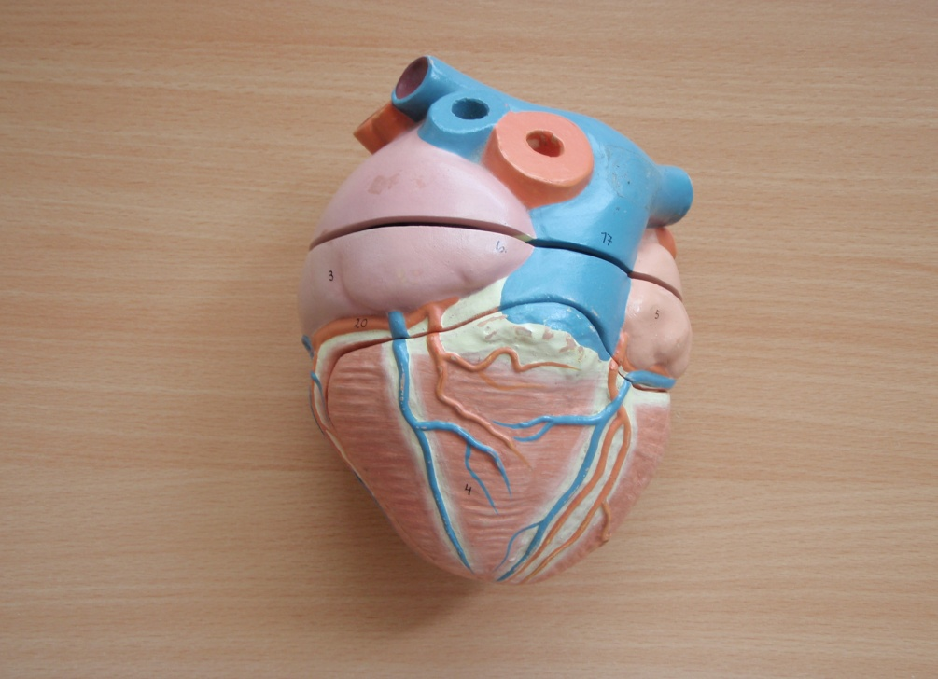
Circulatory system
The HEART pumps the blood around the body.

Slide 10
C.S.
HEART
The heart is a muscle in the chest.
It contracts to pump blood.

Slide 11

C.S.
  HEART

Slide 12

C.S.
What side is left?

Slide 13
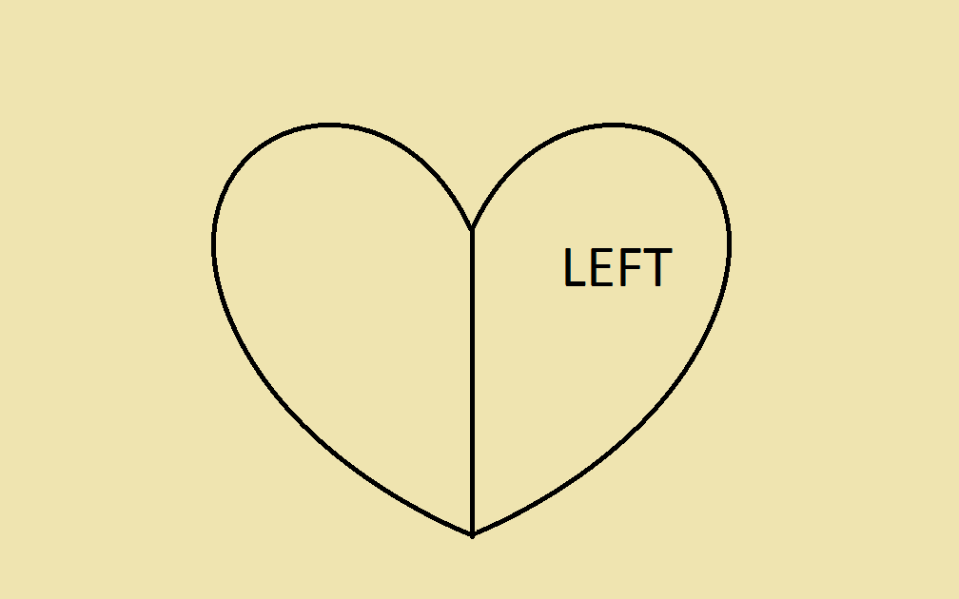
C.S.
What is the other side?

Slide 14
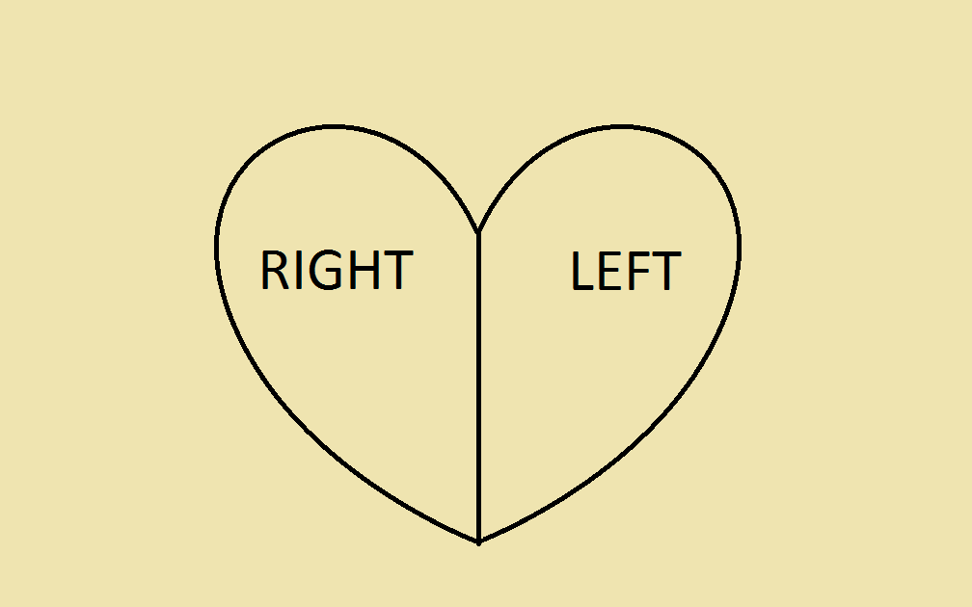
C.S.
Right.

Slide 15
C.S.
Where is the bright red blood ?
(on the left or on the right ?)

Slide 16
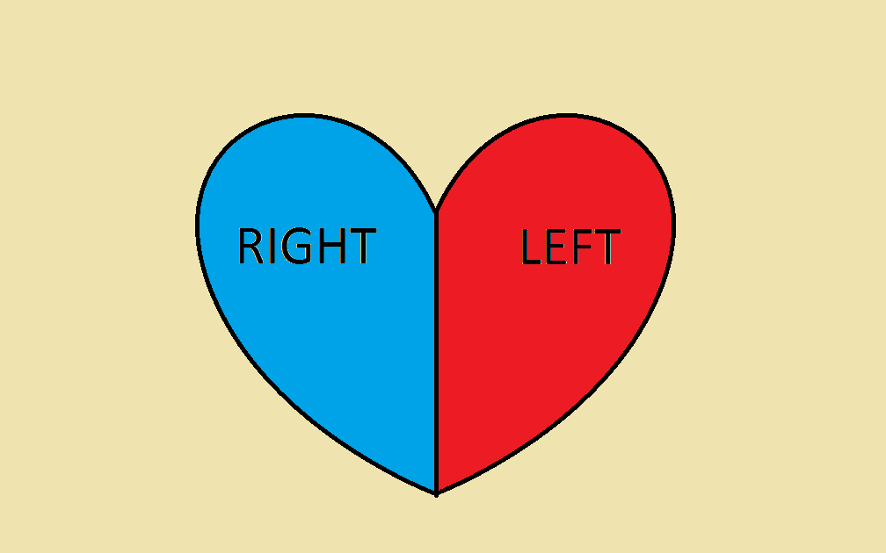
C.S.
The blood on the left side of the heart is full of oxygen.

Slide 17
C.S.
The blood on the right side of the heart is without oxygen. It is dark red or purplish.

Slide 18
C.S.
How many parts does the human heart have?

Slide 19

C.S.
Four.

Slide 20
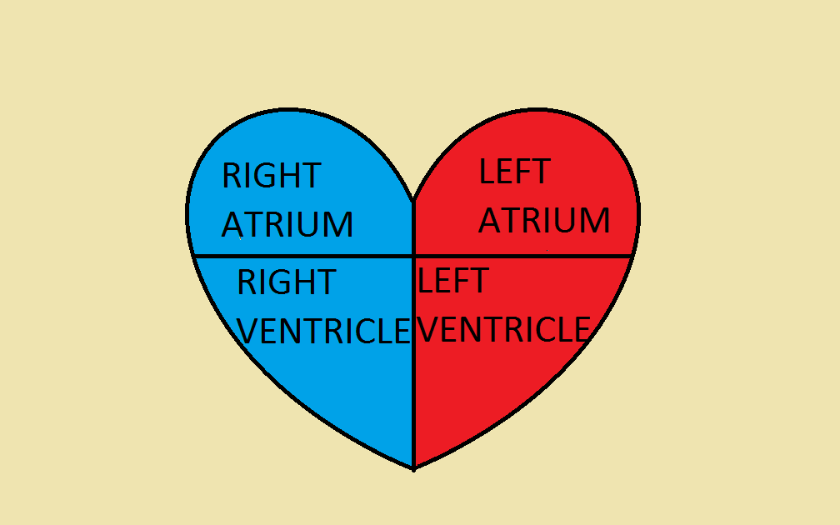
C.S.
4: R A , L A , R V , L V

Slide 21
C.S.
BLOOD CIRCULATION:

Slide 22
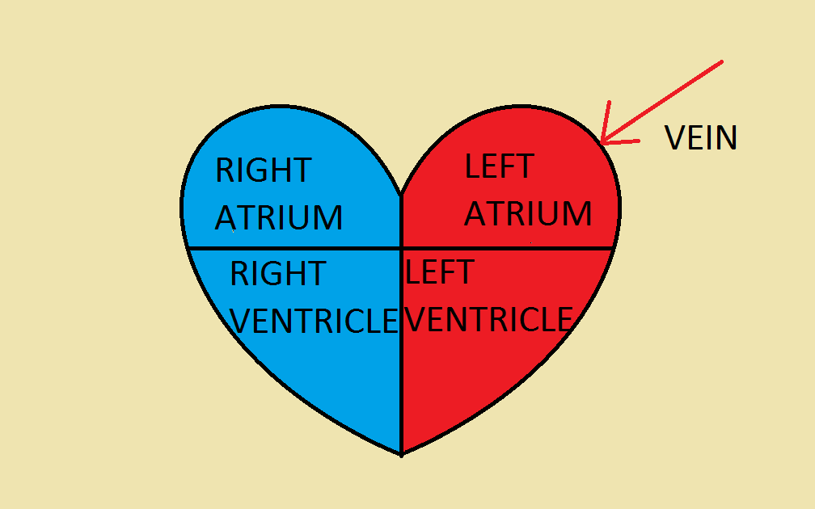
from the lungs

Slide 23
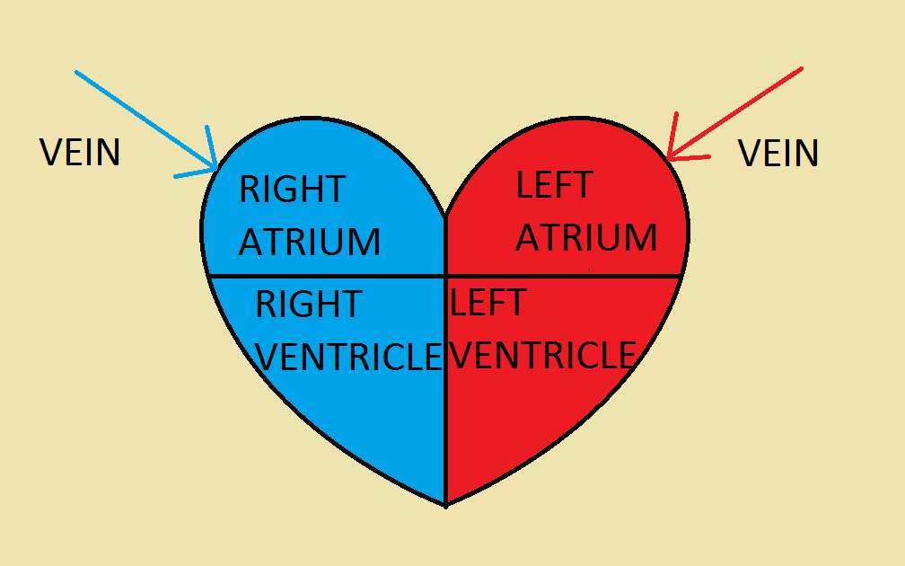
C.S.
from the body

Slide 24
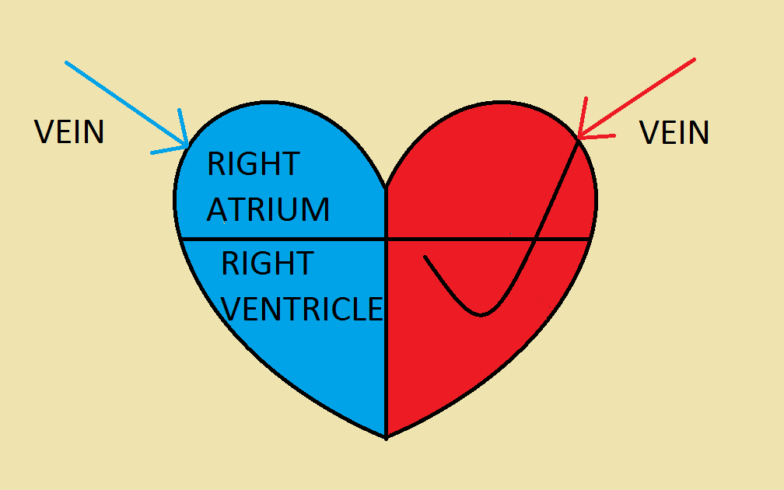
C.S.
from the atrium to the ventricle

Slide 25
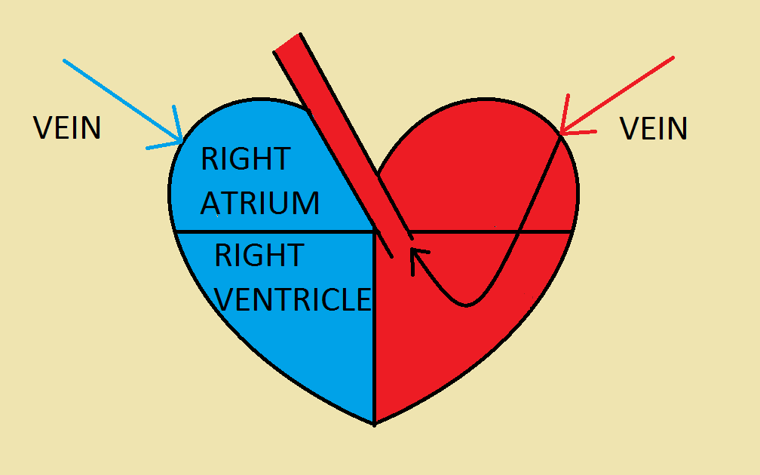
C.S.
from the ventricle to the artery (aorta) and to the body

Slide 26
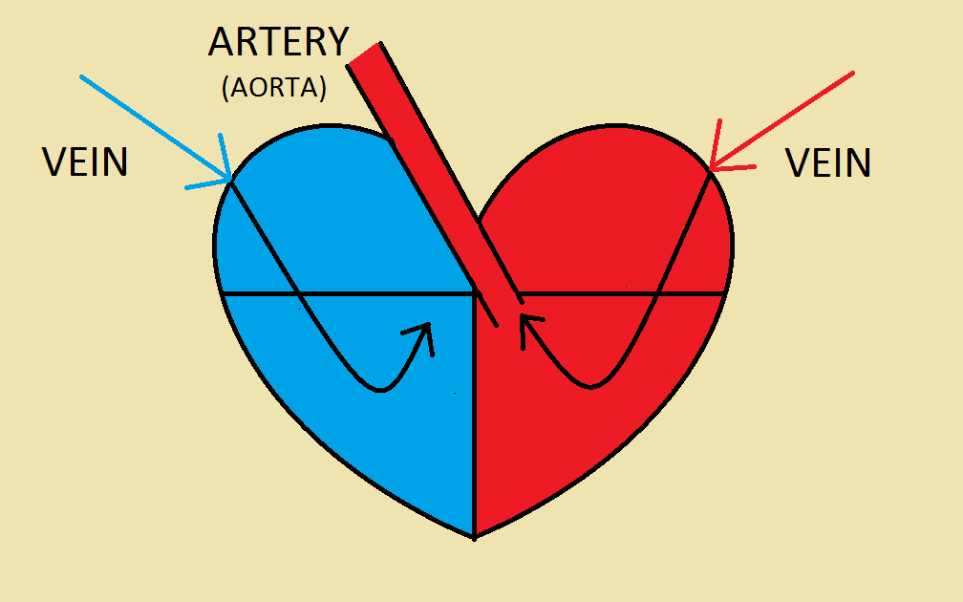
C.S.
from the atrium to the ventricle

Slide 27
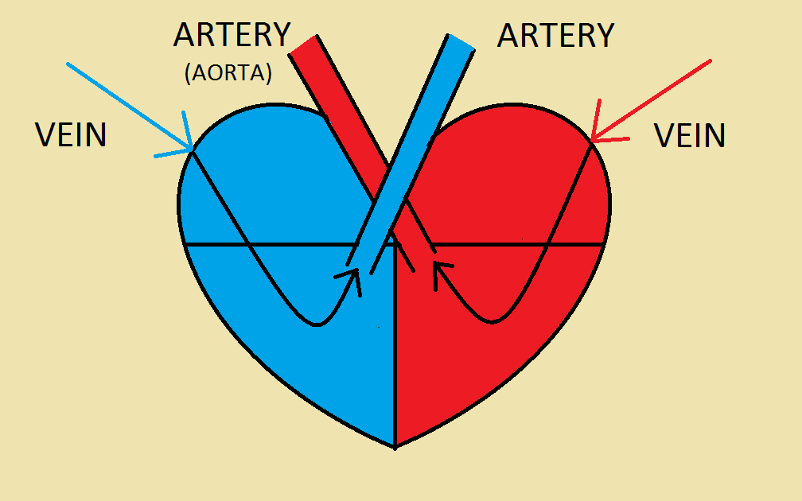
C.S.
from the ventricle to the artery and to the lungs

Slide 28
C.S.
Why does the blood move only in one direction ?

Slide 29
C.S.
THERE ARE VALVES: between the atrium and ventricle
and between the ventricle and artery

Slide 30
C.S.
TRICUSPID VALVE BICUSPID VALVE
trojcípá chlopeň dvojcípá chlopeň

Slide 31
C.S.
SEMILUNAR VALVE SEMILUNAR VALVE
poloměsíčitá poloměsíčitá
chlopeň chlopeň

Slide 32
C.S.
Name 3 parts of the circulatory system.

Slide 33
CIRCULATORY SYSTEM
1) BLOOD

Slide 34
C.S.
2) HEART

Slide 35
C.S.
3) VEINS, ARTERIES AND CAPILLARIES

Slide 36
C.S.
Answer in pairs:
How many parts does the heart have?
Can you name them?
Where is the bright red blood?(on the left side or on the right side)
Why is this blood bright red?

Slide 37
C.S.
2 atria and 2 ventricles
The left part has oxygenated blood from the lungs

Slide 38
C.S.
Describe the way of blood from the lungs to aorta.

Slide 39
C.S.
Why does the blood move only in one direction ?

Slide 40
C.S. CHLOPNĚ
cípaté poloměsíčité
(atrioventricular) (aortic and
chlopně pulmonary)
chlopně

